Slide 1
2022 Internship Orientation
Program expectations, requirements & additional information

Slide 2
Meet your mentors & ATOM colleagues
Titli Sarkar, PhD | Data Scientist at ATOM / FNL
Sean Black, MS (in progress) | Data Scientist at ATOM/FNL
Caleb Class, PhD | Bioinformatician at Butler University
Maggie Scully, PhD | Partnership Development Manager, FNL
Naomi Ohashi, MPA, PMP | ATOM Project Manager, ATOM/FNL

Slide 3
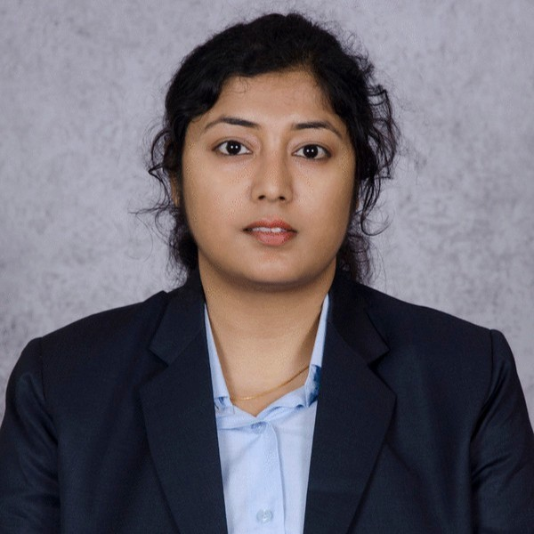
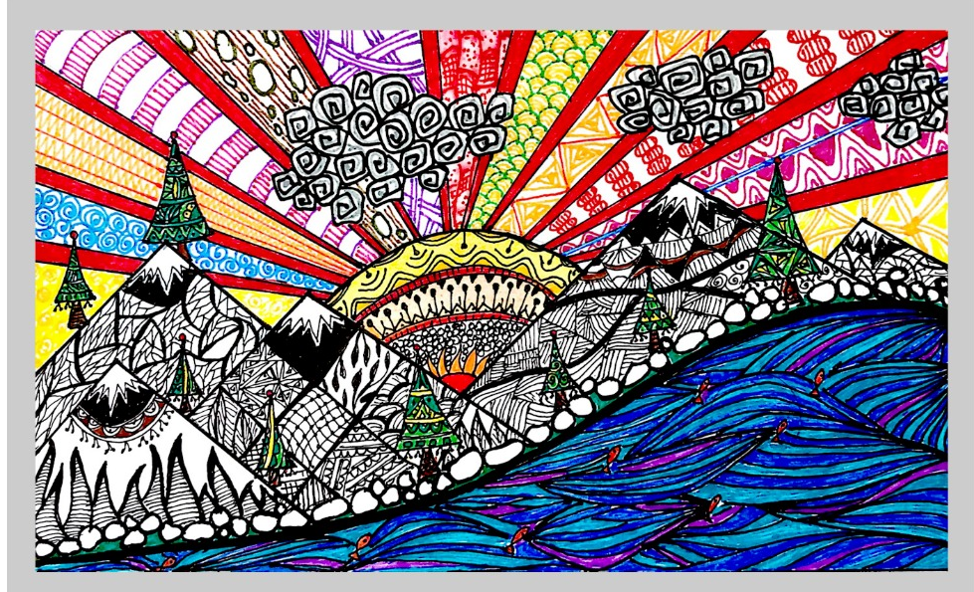

Titli Sarkar
ATOM Data Scientist
My Experience
Predictive Data Analysis for geometry-based Protein 3D Structures modelling
Joined FNL February 2022, now validating AMPL models + working on GMD
Education
MS+M.Tech, Computer Science, University of Calcutta
PhD, Computer Science, University of Louisiana at Lafayette
About Me
I grew up in The City of Joy! … , India
Moved to US for Ph.D
I like cooking, feeding good food to people makes me happy
I am an audio jocky in Bengali and love to paint and write
I have an analytical mind – I try to question and reason everything!
titli.sarkar@nih.gov
Sunrise| Lockdown Dreams |
Mahbubani Painting by me!
https://www.youtube.com/watch?v=q4uezS1ErJg

Slide 4
Titli Sarkar
ATOM Data Scientist
Scientific & Technical interests:
I am interested in developing ML predictive models for drug targets. In order to shorten the drug development timeline, it’s crucial to be able to not only predict properties of a compound but optimize them as well.
What are your goals for the internship?
I want to support the interns and make sure they have a fun, successful summer.
What you hope to accomplish from your internship?
I hope to see each student learn about computational drug discovery and end the summer with great progress made on their projects which is shown in their final presentations.

Slide 5
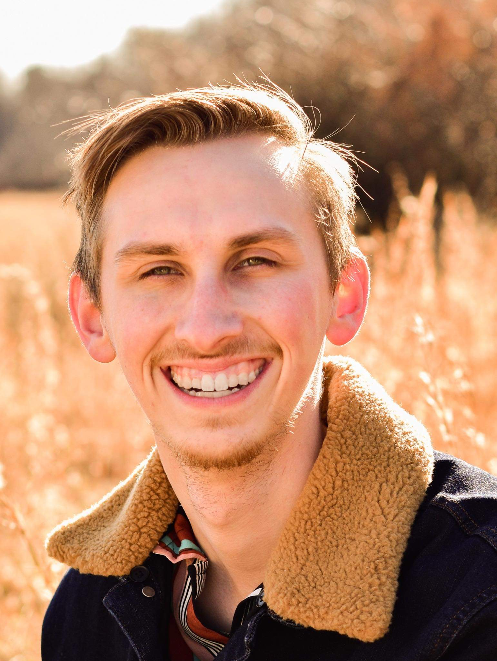
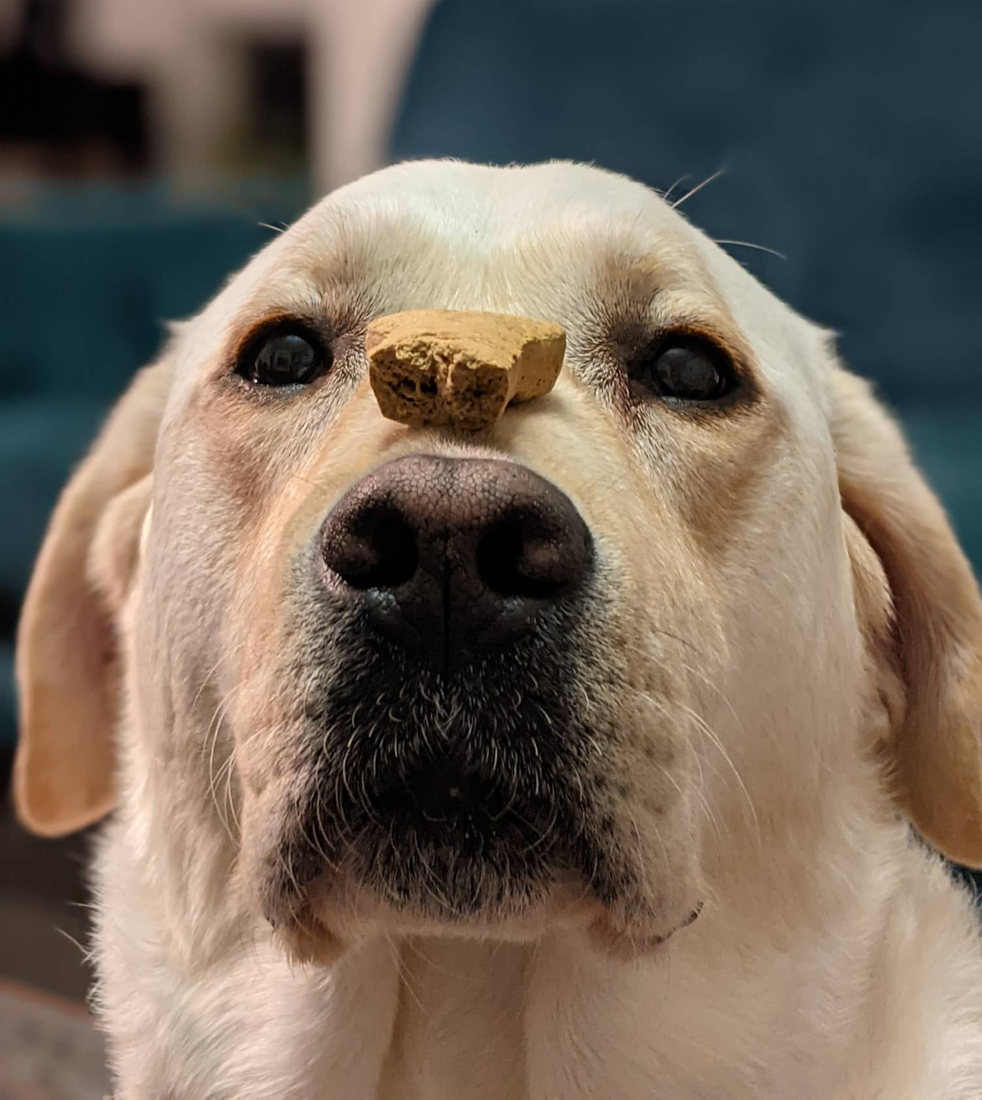
Sean Black
ATOM Fellow
My Experience
I held several internships during high school and undergrad working on Additive manufacturing, ship design, and systems engineering.
Since then, I have worked as a data analyst on various systems and simulations for the US Navy.
I have worked at FNL since November 2021 working on training AMPL models and improving the generative molecular design software
Education
BS, Engineering & Physics with minor in Math, Frostburg State University
MS, Artificial Intelligence (In Work), Johns Hopkins University
About Me
I grew up in Maryland, but now live in NYC
I love to travel and bake

Slide 6
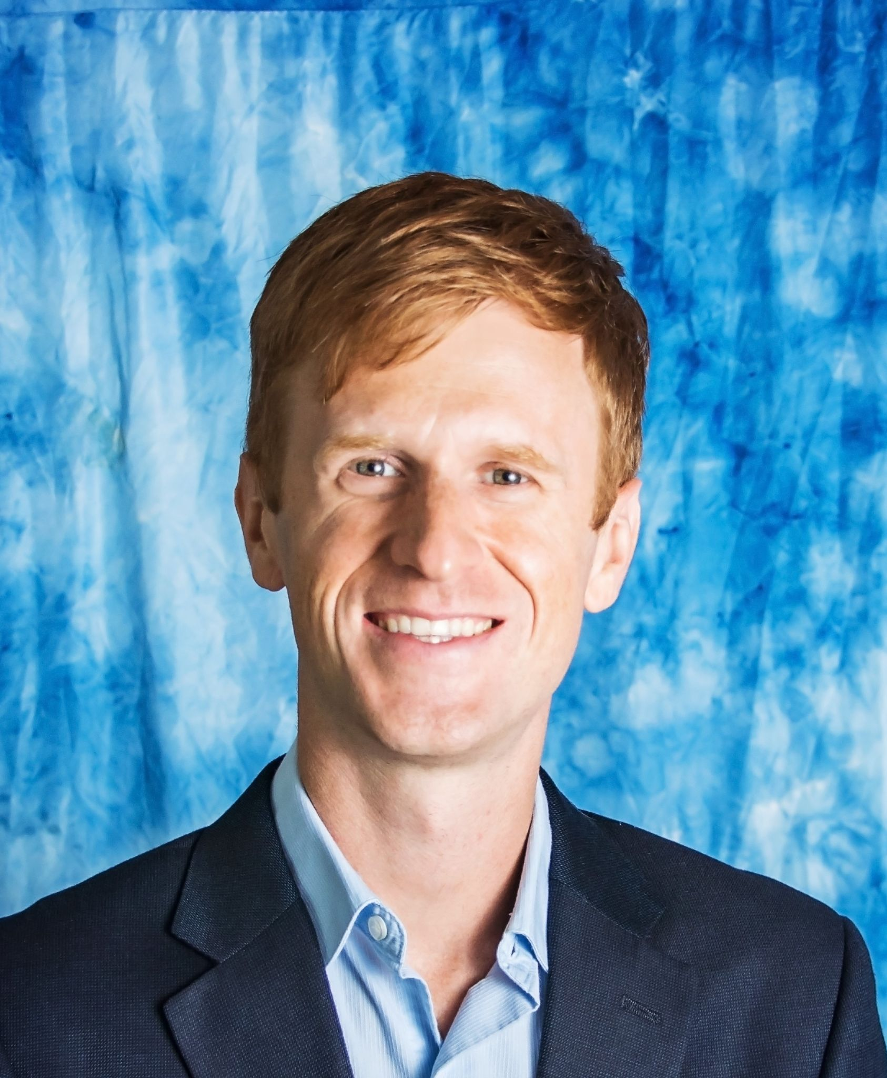
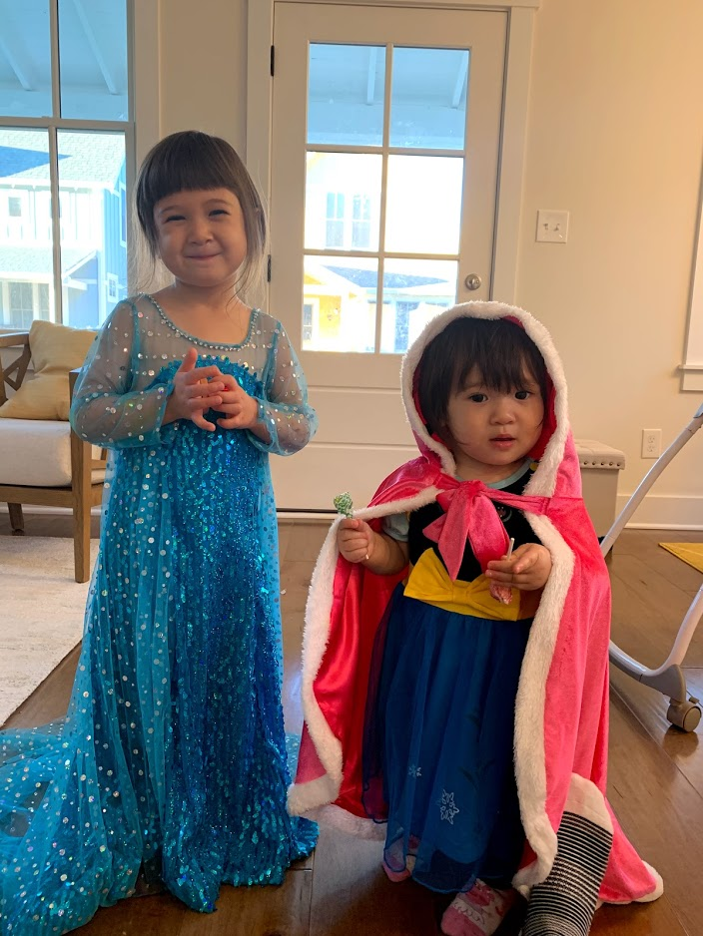
Caleb Class
Butler University - Bioinformatics
My Experience
Assistant Professor at Butler University (Pharmaceutical Sciences) since 2020
Teaching Data Analysis, Bioinformatics & Medicinal Chemistry courses
Analyzing and developing tools to understand ‘Omics data
Researcher at MD Anderson Cancer Center (Houston) from 2015-2020
Education
B.S. Chemical Engineering, Purdue University
Ph.D. Chemical Engineering, MIT
Keywords
Running
Cooking/Eating
Running+Eating - Organized Pieathlon during grad school (3.14 mile run + pie)
No pets (2 children)

Slide 7
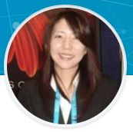
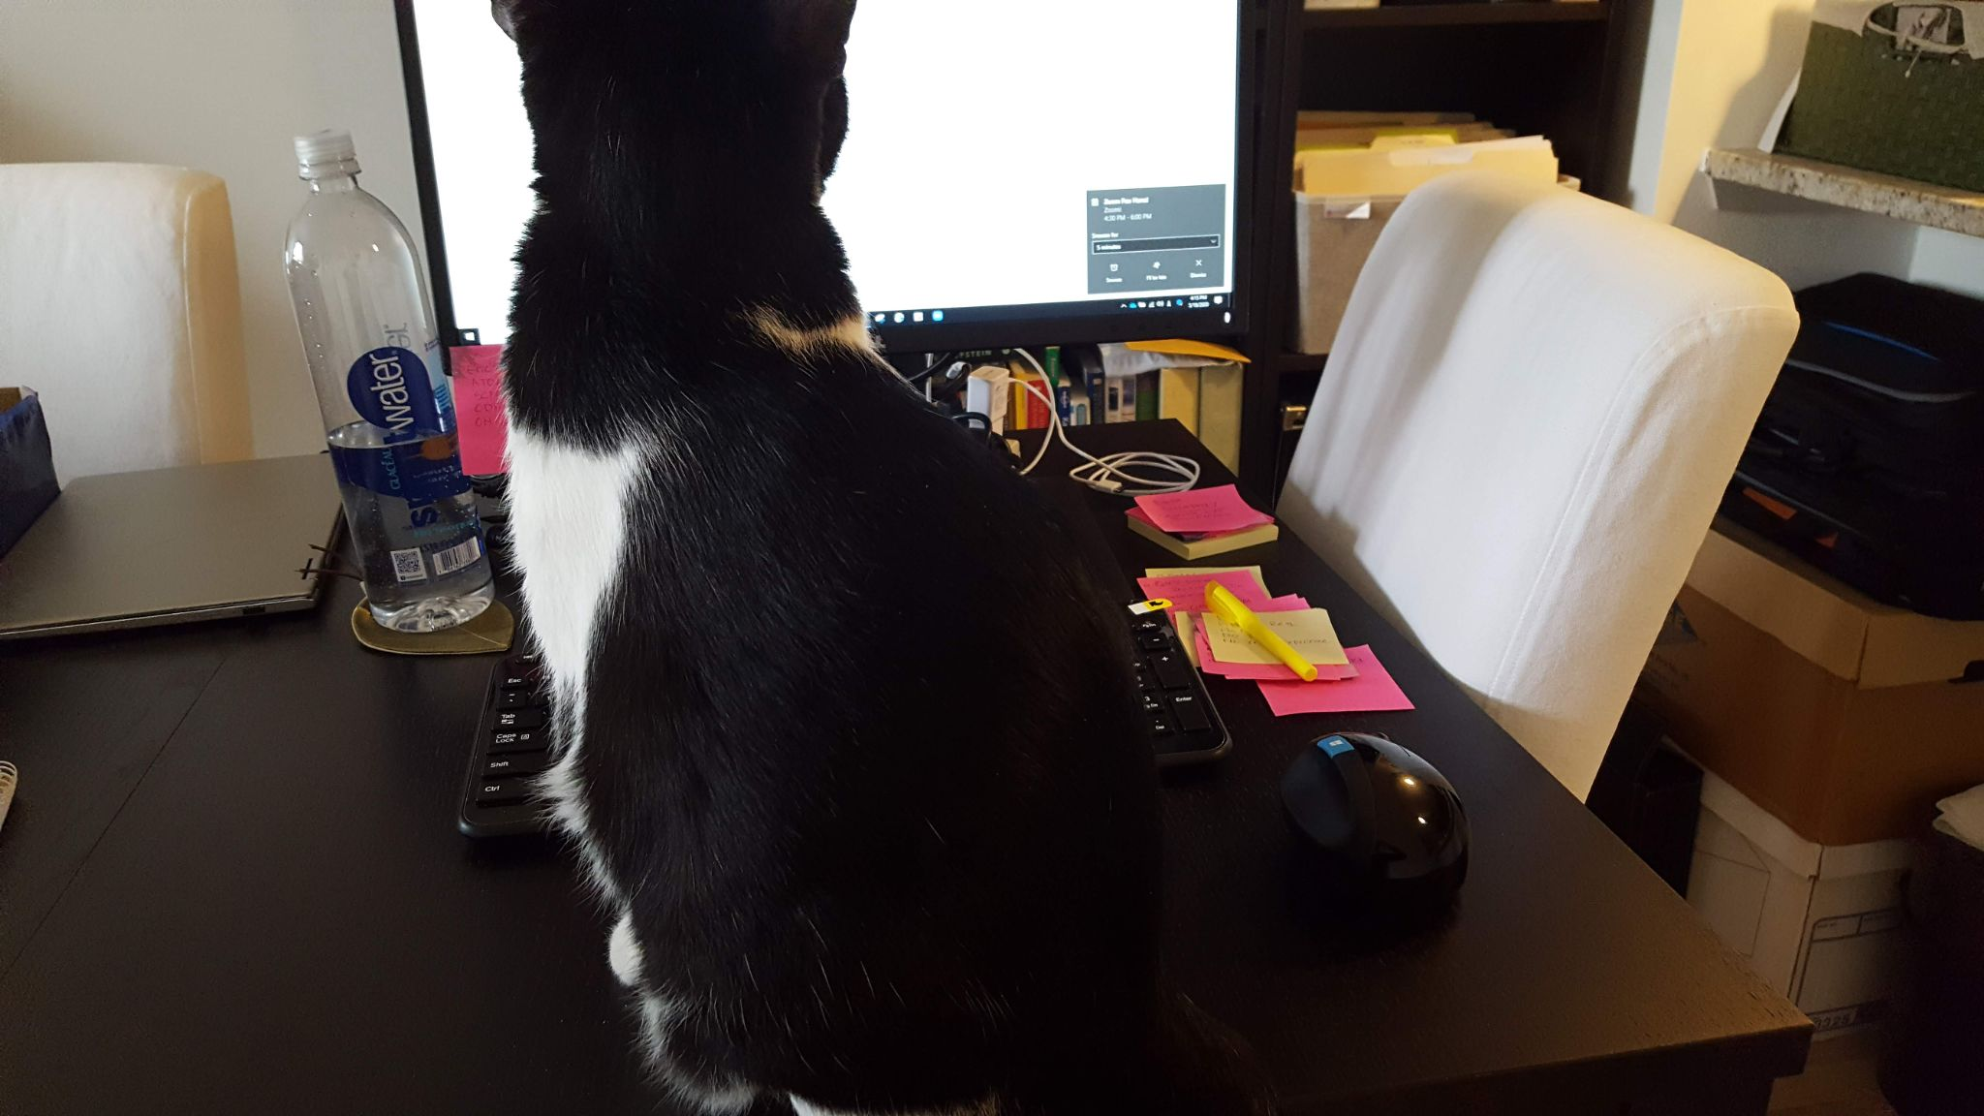
Naomi Ohashi
ATOM Technical Project Manager
My Experience
Certified project manager at the Frederick National Laboratory for Cancer Research (FNL) for 10+ yrs.
Background in business development, project management, finance in both public and private industries.
Provide PM support to ATOM R&D teams.
Work with the ATOM operations team to support ATOM leadership teams.
Education
M.P.A., New York University Wagner School of Public Service
B.A., Syracuse University, International Relations
Keywords
Grew up in Tokyo, Japan, educated in New York
Enjoy running (26.2 miles is the longest distance I’ve done)
Like traveling exotic places (Been to Morocco, Spain, Hungary, Slovakia and more. Next is Southeast Asia or Mars).
Have a black & white cat who has a bunny-like, short tail
naomi.ohashi@nih.gov
“I’m working hard.”

Slide 8
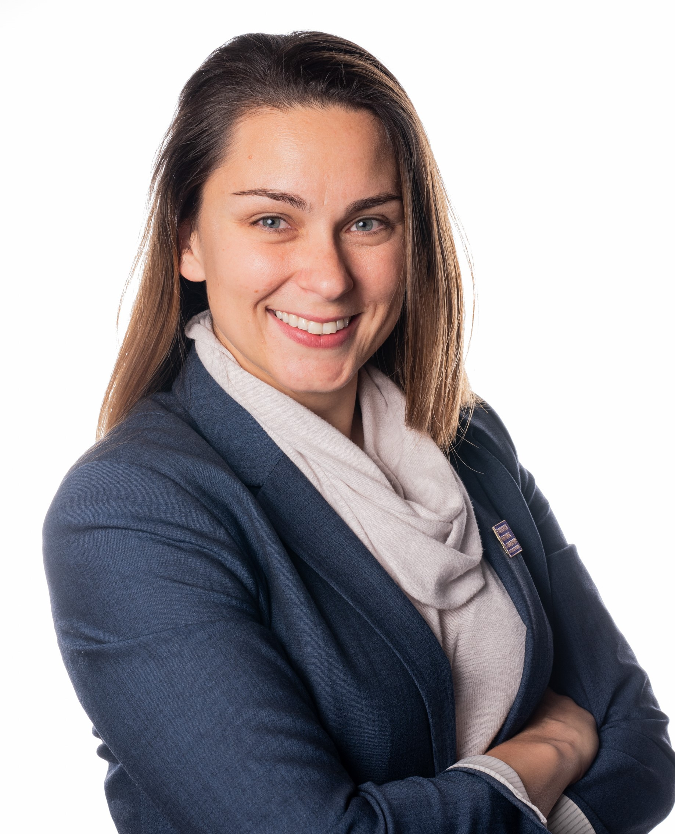
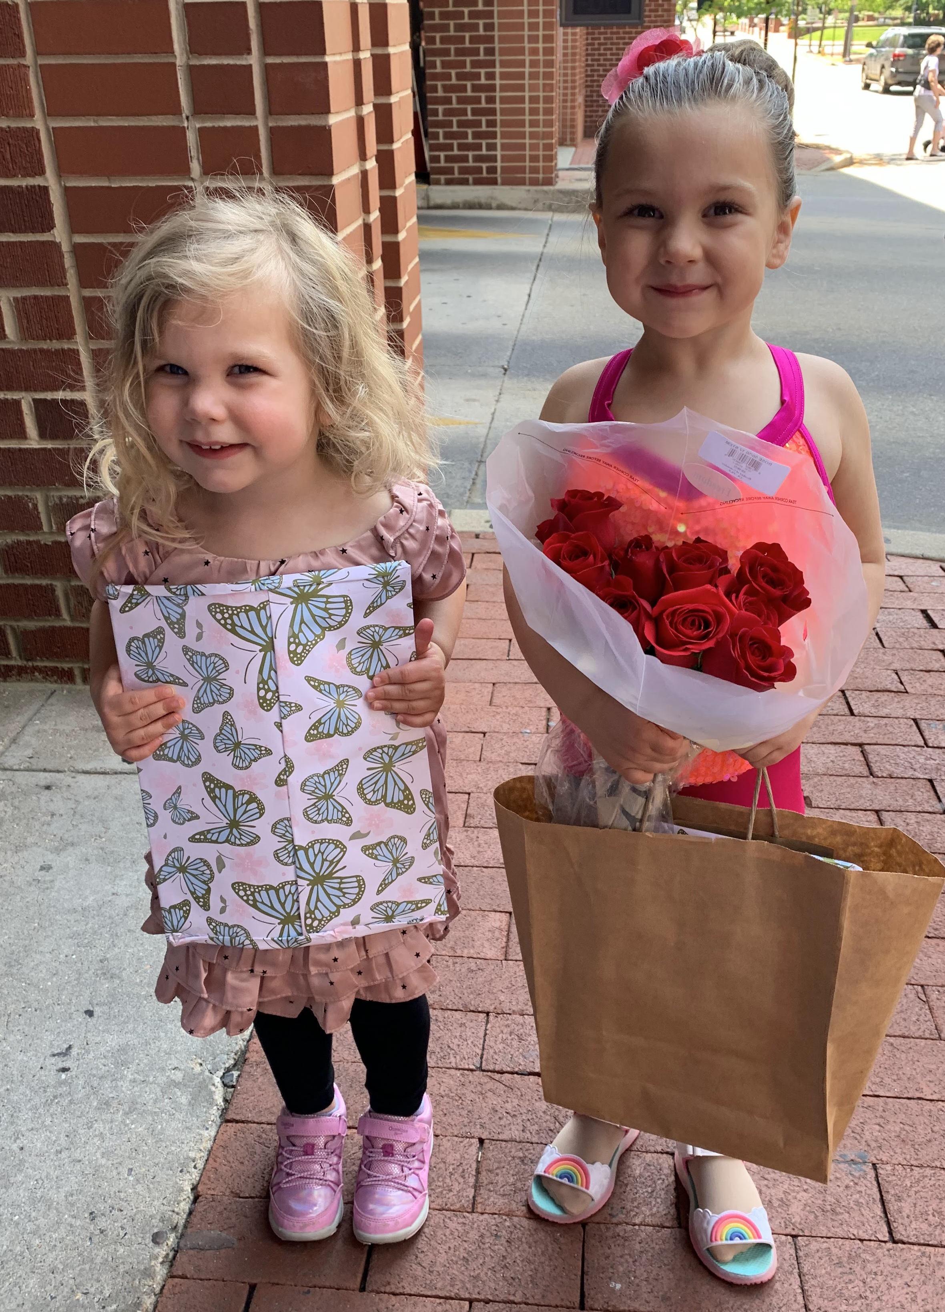
Maggie Scally
Frederick National Laboratory for Cancer Research – Partnership Development Office
My Experience
Partnership Development Manager, Academic Partnership, Trainee Program
Nanomedicine researcher, cancer nanomedicine, imaging agents
Start-up founder on half-life extension technology, peptides & proteins Predoctoral fellow at NIBIB, NIH
Postdoc at Johns Hopkins SOM, Department of Radiology
Education
B.S. Bioengineering, Lehigh University
Ph.D. Biomedical Engineering, Stony Brook University
Keywords
Not running
Polish – Magdalena Swierczewska
Caroline & Claire
maggie.scally@nih.gov

Slide 9
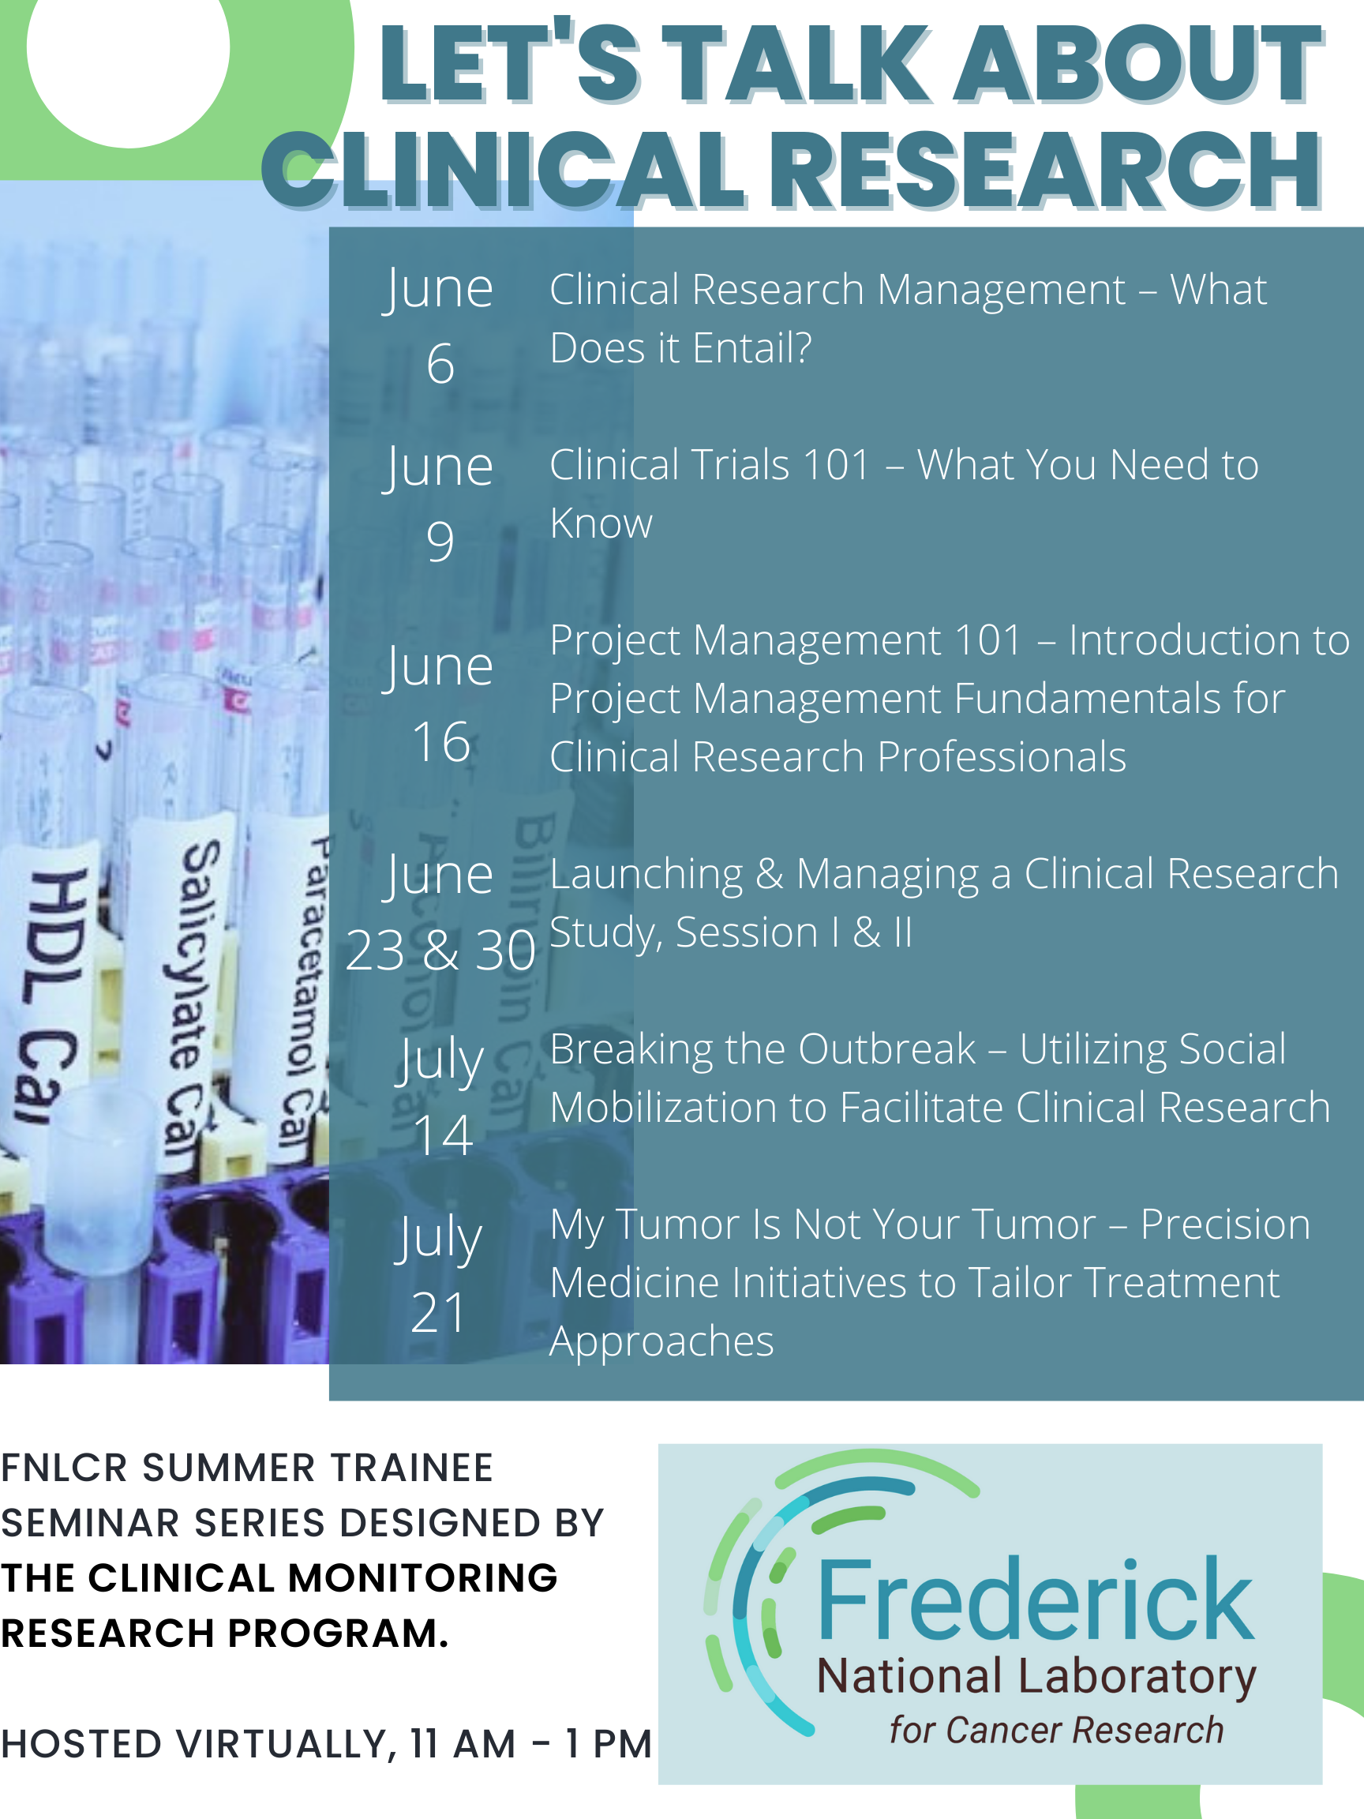

Slide 10

About
Mission: Transform drug discovery by accelerating the development of more effective therapies for patients
Culture: Transparency, Integrated, and Engaged
Communication: Teams channel, /Teams/Zoom Meetings, Email
Confidentiality: Be aware of the information you receive and disseminate
Learn More! We are here to help for any questions!

Slide 11
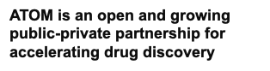

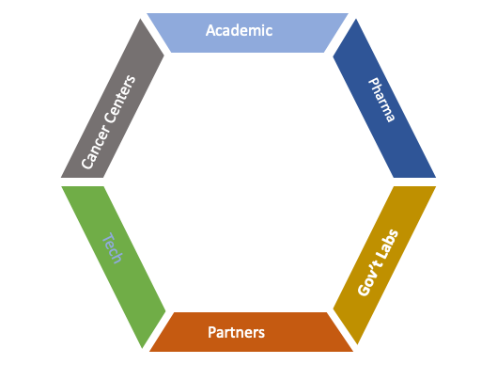







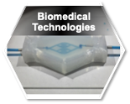


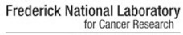





ATOM Info - consortium structure

Slide 12
The ATOM Team – Year 5, Q2
JRC
Belinda Akpa
Jim Brase
Eric Stahlberg
Michelle Arkin
Dwight Nissley
Tom Brettin
Frank Alexander
R&D Management
BD/Ops
Jonathan Allen
Naomi Ohashi
Amy Gryshuk
Vladimir Popov
Naomi Ohashi
Ryan Weil
Becky Lein
Maggie Scully
Data Framework and Partnerships
Kevin McLoughlin
Human Systems Models and Data
Stewart He
Hiran Rangathan
Predictive Modeling
Soo Kim
Jonathan Allen
Jonathan Allen
Marisa Torres
Yaru Fan
Generative
Molecular Design
Michelle Arkin
Adam Zemla
Kevin McLoughlin
Derek Jones
Jeff Mast
Sam Ade
Active Learning
Sergio Wong
Dan Kirshner
Brian Bennion
Eric Stahlberg
Belinda Akpa
Frank Alexander
Amanda Paulson
Felice Lightstone
Pinyi Lu
Sean Black
Pinyi Lu
Sean Black
Byung-Jun Yoon
Nathan Urban
Natalie Isenberg
Lav Varsheny
Experimental Design
Amanda Paulson
Jeffrey Neitz
Jezrael Revalde
Manasi Jogalekar
Yagmur Doruk Polcyn
Morgan Diolaiti
Prasanna Kandel
Michelle Arkin
Titli Sarkar
Jonathan Allen
Titli Sarkar
Kristofer-Roy Reyes
As of May 2022

Slide 13
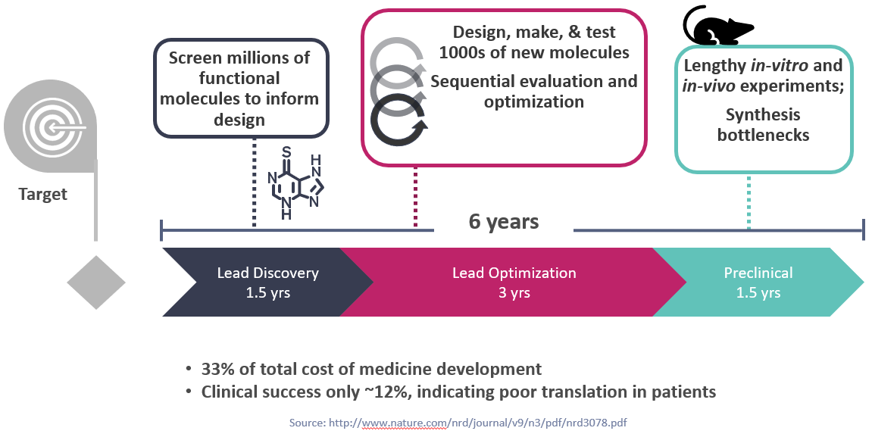
Challenges in Drug Discovery
ATOM: Acerating Therapeutics for Opportunities in Medicine

Slide 14
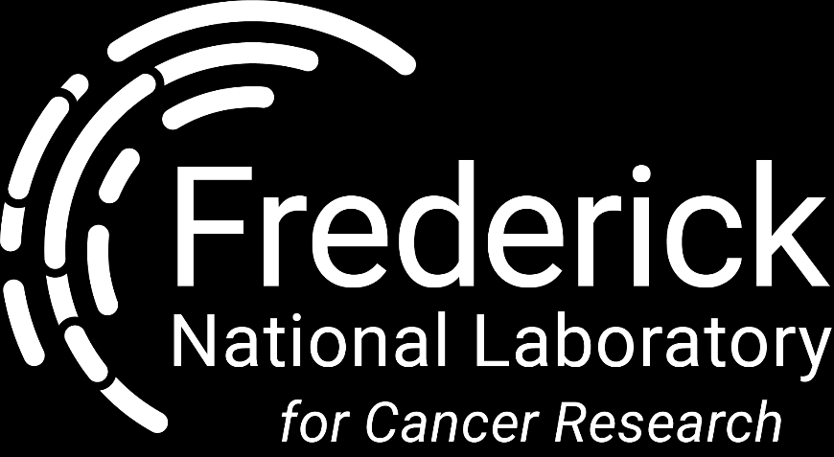
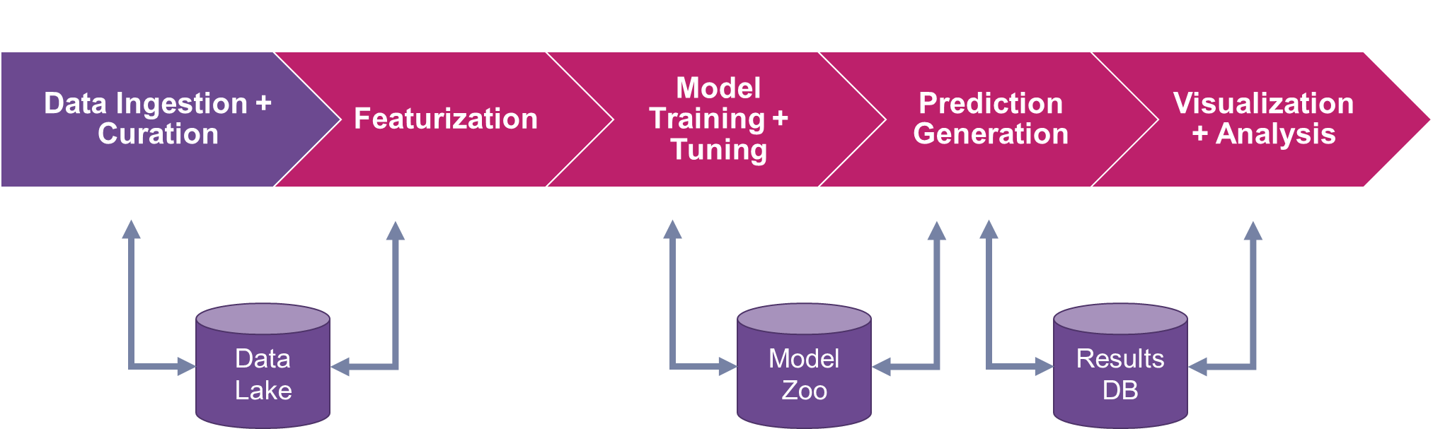
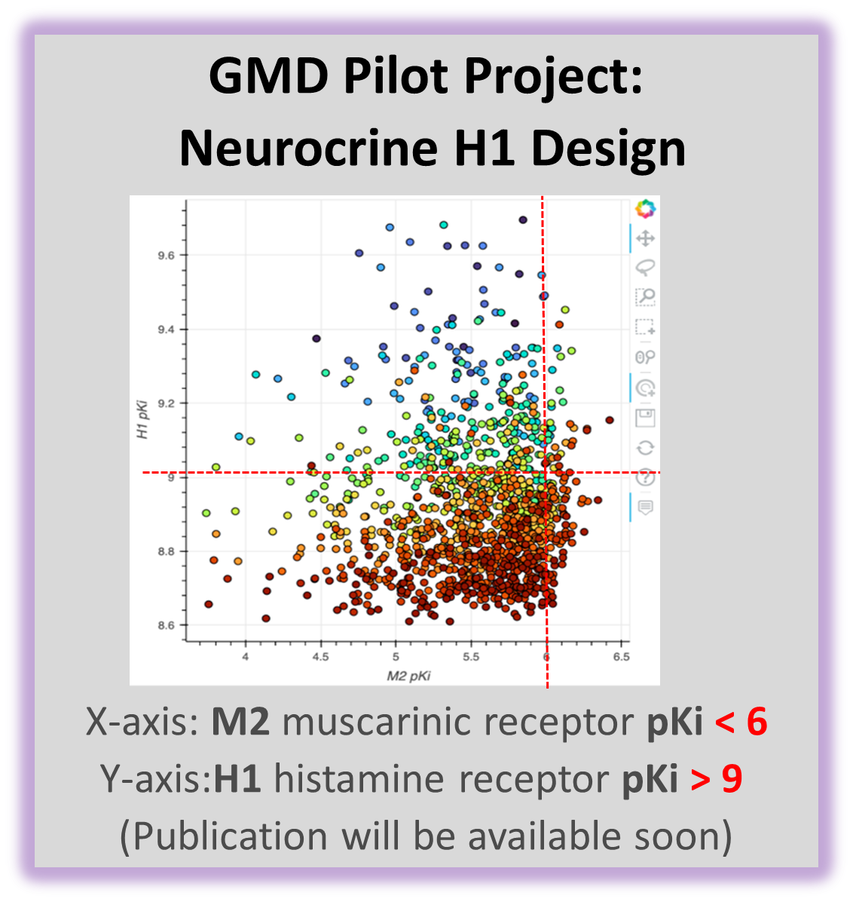
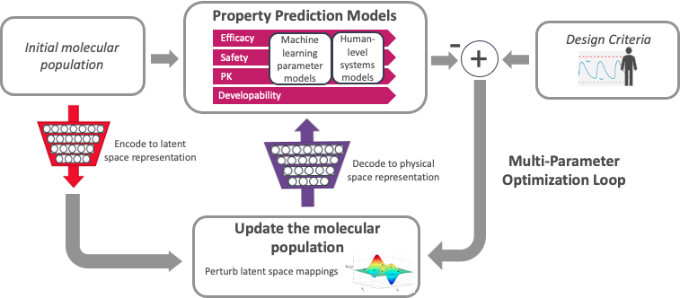


ATOM Workflow
#ATOMScience
@FredNatLab
#AI #ML #AMPL
ATOM Workflow
1. AMPL Pipeline
AI and computing-driven molecular discovery and optimization
Molecular data library Open curated and model-ready database
1. AMPL
2. GMD
1. AMPL (ATOM Modeling PipeLine) :
Predictive modeling: training, optimization, and property prediction
2. GMD Design Workflow
Cancer Drug Discovery (new molecules Optimized Properties)
Publicly Available Data and Models:
ATOM Science-org/AMPL
Model and Data Clearinghouse (MoDaC)
Molecules with
Optimized Efficacy
AMPL Tutorial
Curated dataset
AMPL Predictive Models
A data-sharing repository
Resources include datasets and software models
Searchable against metadata and downloadable
2. GMD: A high-performance platform for parallel optimization of efficacy, safety, and pharmacokinetics

Slide 15
Meeting & intros with the extended ATOM team
At the Tech Team Meeting 5/25, 1pm ET
Create your own bio slide & scientific + technical interests slide - due to Becky 5/24, 5pm ET
Introduce yourself at the meeting, ~1-2 minutes
I will send out a template & instructions after the meeting
You need to sign a Photo release form – sign and return by email

Slide 16
Program expectations
Full time, 40 hour work weeks. ~9am - 5pm ET
Most important hours: overlaps with fellow colleagues ~12-5pm
Required attendance at all meetings:
Bootcamp Sessions
Weekly Group Meetings
Ad-hoc Seminars
Tech Team Meetings
Successful completion of all assignments & final presentations

Slide 17
Time off & conduct
The internship is full time, all summer. If you have an unavoidable conflict, notify Titli ASAP and we will work out how to make up the time
You are expected to follow the ATOM code of conduct & your school’s code of conduct

Slide 18
Professionalism
ATOM’s culture is open and friendly.
Most people are OK being called by their first names - just ask!
Everyone is very nice and willing to help you out with questions. Don’t be afraid to reach out via email or Teams.
Be on time for all meetings
Follow good email etiquette
be respectful, spell things properly, respond in a timely manner
Follow good video meeting etiquette
Try to keep your camera on for most meetings.
If you share space, a virtual background can help it be less distracting.
Always mute yourself if not talking.
Use headphones

Slide 19
Mentor availability & day-to-day schedule
Check-in every morning @9am ET. A 15-mins quick session with Titli about troubleshoot, daily update etc.
Update the daily check-in excel sheet in Google Drive and show in morning check-in
Google Drive link: https://drive.google.com/drive/folders/1SEnsq9t9mxzvk_G9tiz9wfl49IXsXUuH?usp=sharing
All mentors available on teams or via email any time within work hours
1:1 Teams calls any time - just reach out to us & we can set it up
Teams work sessions in the afternoons - 1-5pm ET every day. Work together here, and mentors will drop-in occasionally if needed

Slide 20
Bootcamps
5/16 - 5/27: Python bootcamp with Caleb
10 am ET every day
Additional check-ins on Teams channel
5/30 – 7/29: Computational drug discovery with AMPL
10 am ET every day
Additional check-ins on Teams channel

Slide 21
Weekly group meetings
Focused on building excellent scientific communication skills
Wednesdays from 2-3:30pm ET
Weekly Update - prepare doc/slides and upload in google drive: https://drive.google.com/drive/folders/1YonwHYAZwBLfrWGct5SFk-7o2ebQQHD3?usp=sharing
Journal clubs
Abstract writing
Additional computational drug discovery topic seminars
Poster creation
Final presentation practices

Slide 22
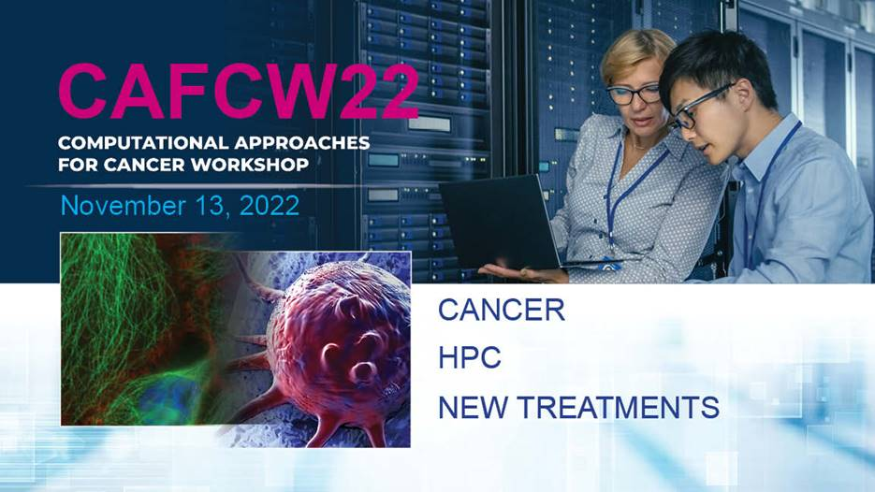
Special event group meeting
Eighth Computational Approaches for Cancer Workshop (CAFCW22) will be held in person on November 13, 2022, 8:30 a.m. to 12 noon, CT, in Dallas, Texas, in conjunction with SC22: The International Conference on High Performance Computing, Networking, Storage and Analysis.
Student Track
CAFCW expanded its reach last year by adding a focus on workforce development. As a part of this effort, we will, once again, be honoring students who may not traditionally attend the workshop (such as undergraduates and students from non-technical degrees) who submit accepted research. They will have a highlighted presentation, opportunities to engage with the Students@SC program, special programing focused on training and workforce development, and further awards to be announced. Students can submit their abstracts at Student Submission Form.

Slide 23
Ad–hoc semnar series
Dates TBD
PharmD and other people with chemistry backgrounds will talk about their career paths and decisions they made to get to where they are.
Your chance to learn about different careers - be prepared to ask lots of questions!

Slide 24
Final presentations
Written abstract that summarizes your research, due on Week 7, July 27, date TBD after you establish your project
~15 minute oral presentation to the ATOM team during the last week of the internship (dates TBD)
Poster session also during the last week (dates TBD)

Slide 25
Work-life balance & virtual work life
Be aware that you’re working with people all over the country - emails come in at odd times, etc.
Don’t feel obligated to do any work outside of your working hours in your own time zone, unless an unavoidable meeting needs to happen.
If possible, carve out a space for yourselves that is “work-only”. It is really easy for the lines between work and home to be blurred. Be respectful of your own time and energy
This is another reason the compute instances will shut down at night!
If you are in the zone or need to work extra / on the weekend, we are happy to accommodate that too!

Slide 26

Important resources
Google drive folder with forms & communications: https://drive.google.com/drive/folders/10SYutXvZ1YxuAHiw5n9CraRsBn_nC4R3?usp=sharing
MS Teams Channel:
https://teams.microsoft.com/l/channel/19%3aF2ar8c-FKhvj_jCsYE_TEfDuhQXzQjeUTstM-fMWBXM1%40thread.tacv2/General?groupId=c08eee28-e901-4693-8326-b2ae8a81d7f8&tenantId=14b77578-9773-42d5-8507-251ca2dc2b06
We are glad to have you here and we hope you get a wonderful training experience!

